Slide 1
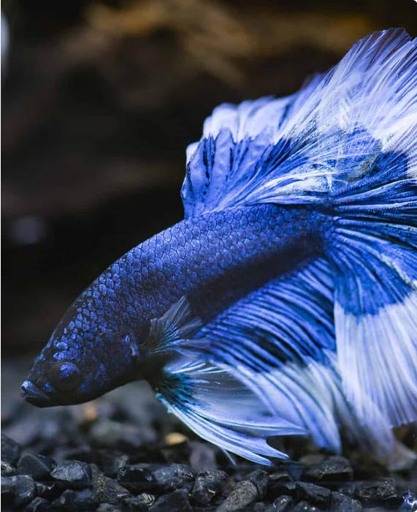
The Fish Feeder
Smart Aquarium Management System

Slide 2


Meet the Team
Madubashini
Supun
Dileesha
Gamage
Sathsara
Bandara
GAHDSE231F-007
GAHDSE231F-008
GAHDSE231F-009

Slide 3
Meet Our Solution for Hassle-Free Fish Feeding
What is Fish Feeder?
A system that is created to automate the feeding process for pet fish

Slide 4
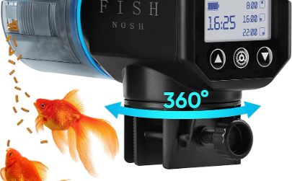
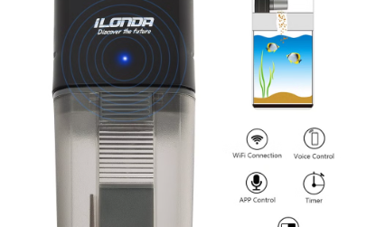
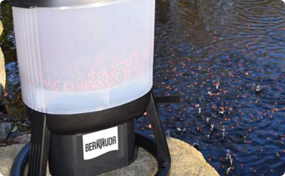
Key Features of Fish Feeder
Automated Feeding
Precise Portion Control
Remote Connectivity
Schedules and dispenses fish food at customizable times.
Delivers the right amount of food to maintain fish health.
Monitor and control the feeder from anywhere via smartphone.

Slide 5
Automated Feeding Schedule
Customizable Schedules
Vacation Mode
Set feeding times and amounts to suit your fish's needs.
Automatic feeding keeps fish happy and healthy when you're away.
1
2
3
Consistent Meals
Ensure your fish receive the right portions at the right times.

Slide 6
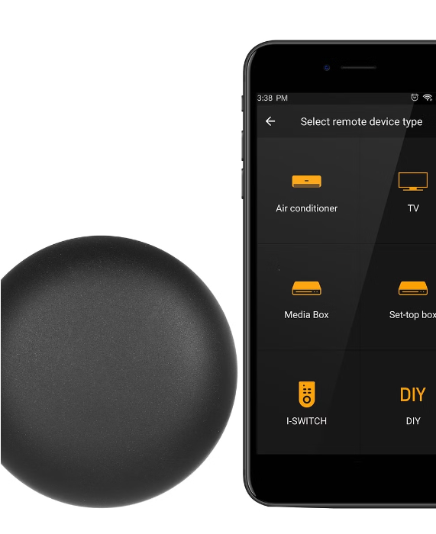
Connectivity and Remote Access
Fish Feeder features WiFi connectivity for remote access and control from anywhere.
Owners can monitor and adjust feeding schedule, portions, and settings via mobile app.

Slide 7



Under the Hood
Hardware
Software
Database
NodeMCU ESP8266
Node.js server
Firebase Realtime datastore
Servo Motor
React Native app
OLED Display
Firebase
Keypad
HiveMQTT broker

Slide 8

Making Waves
Charting the Course of Communication and Control
User Interaction:Via app and keypad;
Command Flow: From Node.js server to NodeMCU;
Data Storage: In Firebase;
Real-time Communication: Through HiveMQTT

Slide 9
Building Bridges
Hardware Assembly: Physical setup and connections
Software Development: Coding the Node.js server and React Native app
Integration: Synchronizing hardware with software
& With all the magic,
Scheduling: How users can set and manage feeding schedules
Manual Feeding: Immediate feed via app or keypad
History Logging: Feeding events tracked in Firebase

Slide 10
Benefits for Fish and Owners
Healthier Fish
Time-Saving
Consistent feeding schedule promotes fish wellbeing.
Automates the feeding process for busy owners.
Peace of Mind
Customizable
Owners can travel without worrying about feeding.
Adjust portions and timing to suit individual fish.

Slide 11
Charting New Waters
Exploring Potential Upgrades and Expansions
Enhanced User Interface
Integration of Additional Sensors
Smart Feeding Algorithms

Slide 12
Conclusion
As we come to the end of our journey through the depths of fish feeding innovation,…

Slide 13

Q & A
Got Any Questions ?

Slide 14

THANK YOU!

